Slide 1
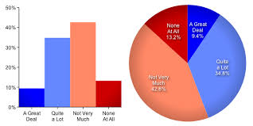
Data transcoding
Transferring of information from text to graphic forms – bar charts, flow charts, pie charts etc.

Slide 2
There are two categories of visuals, namely tables and figures. Figures may be further classified into graphs, maps, drawing, charts, diagrams and photographs

Slide 3
There are many different types of diagram and chart. To help decide which best suits your needs, each of the following is looked at in detail below:
Bar chart
Histogram
Pictogram
Pie chart
Scattergram
Stem and leaf plot.

Slide 4
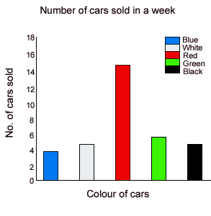
It represents data in terms of bars of equal width, whose height varies to represent the size of the data. Also note that the bars can be any width, and sometimes may be just thin vertical line.

Slide 5
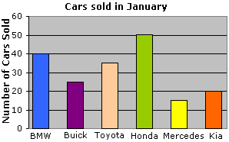
example

Slide 6
A bar chart is particularly useful when one or two categories 'dominate' results. In the diagram above, it is clear that red cars are the most popular.
It can be very clear and easy to read.
Most people understand what is presented without having to have detailed statistical knowledge.
It can represent data expressed as actual numbers, percentages and frequencies.
A bar chart can represent either discrete or continuous data.
If the data is discrete there should be a gap between the bars (as in the diagram above).
If the data is continuous there should be no gap between the bars.

Slide 7
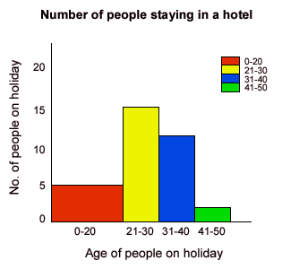
A histogram looks similar to a bar chart, but in this case the area of the bar or rectangle varies with the data, rather than just the length.

Slide 8
When to use a histogram:
It can only be used to represent continuous data.
It can represent data expressed as actual numbers, percentages and frequencies.
It is really only of value if the reader gets more information from a chart where the classes are different sizes.

Slide 9
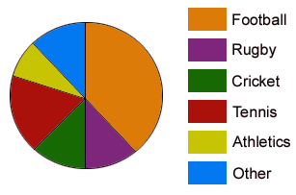
A pie chart shows data in terms of proportions of a whole. The 'pie' is divided into segments that represent this proportion. This is done by dividing the angles at the centre.

Slide 10
When to use a pie chart:
It is best used to present the proportions of a sample.
It is most useful where one or two results dominate the findings.
It can represent data expressed as actual numbers or percentages.
Do not use where there are a large number of categories, or where each has a small, fairly equal share, as this can be unclear.

Slide 11
You can use connectives (ex: next,then,first, second, finally,meanwhile,eventually,after,before and,also,but,likewise,unlike,therefore,due to ,such as ,significantly,indeed,moreover in particular,especially

Slide 12
Also the following words
gradually increasing
a slight fall
kept rising
reached a peak
increased at a steady rate
fell
increased sharply
a low of
finish at
stood at
finishing the period at

Slide 13
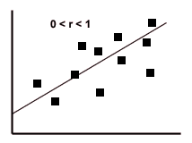
A scattergram shows how two sets of numerical data relate to each other.

Slide 14
When to use a scattergram:
These are used to show patterns of correlation between two sets of data - ie how 'connected' the data is. Eg there is likely to be a connection between height and shoe size but there is not a connection between height and eye colour.
Each point represents one relationship (eg one person’s height and shoe size). A 'line of best fit' can be inserted to show a trend (see above).

Slide 15
What is a Flow Chart ?
An organized combination of shapes, lines, and text that graphically illustrates a process or structure
A pictorial representation showing all of the steps of a process
Flow charts deal with the different steps involved in making/manufacturing some material or the process of a person’s growth or transfer of some information

Slide 16
Basic Flowchart Shapes and Definitions
Start / End
Project / Task
Input / Output
The start or end of a workflow.
Process or action.
Data: Inputs to, and outputs from, a process.
Split
or
Merge
Decision
Document
Upright indicates a process split, inverted indicates a merge of processes.
Decision point in a process or workflow.
Document or report.
Off Page Connector
Manual Input
Connector
Prompt for information, manually entered into a system.
Used to connect one part of a flowchart to another.
Connector used to connect one page of a flowchart to another.

Slide 17
Making Popcorn
Turn on the kettle and the warmer
Insert The Ingredients:
One cup of popcorn oil
Two cups on popcorn
One half tablespoon of popcorn salt
Let ingredients heat up and start popping
Once popping has slowed to a couple of pops
every few seconds then dump kettle out.
Repeat Process

